Slide 1

Journey Presentation WEEK 5
Aayush Tomar (ida batch 1)

Slide 2
CUSTOM TRAINING

Slide 3

DAY 10: 12-09-2023
Introduction to Azure Synapse Analytics
Serverless vs Dedicated SQL Pools
Wrote SQL Query on top of a file
Created external table on top of a file (No DML Operations can be performed)
Created a table and perform bulk load

Slide 4
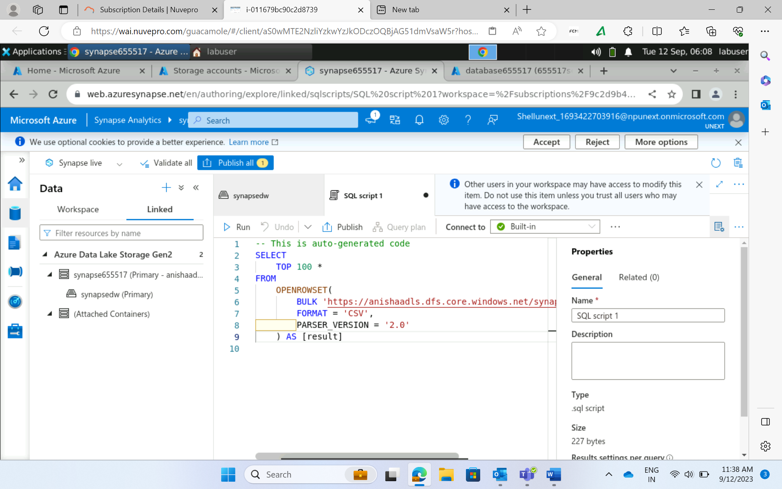
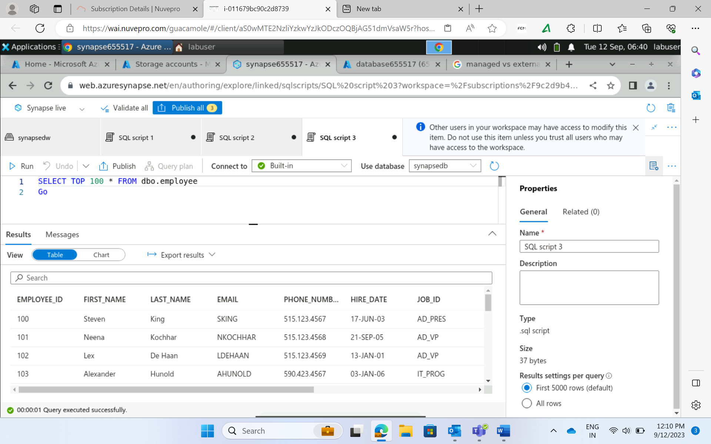
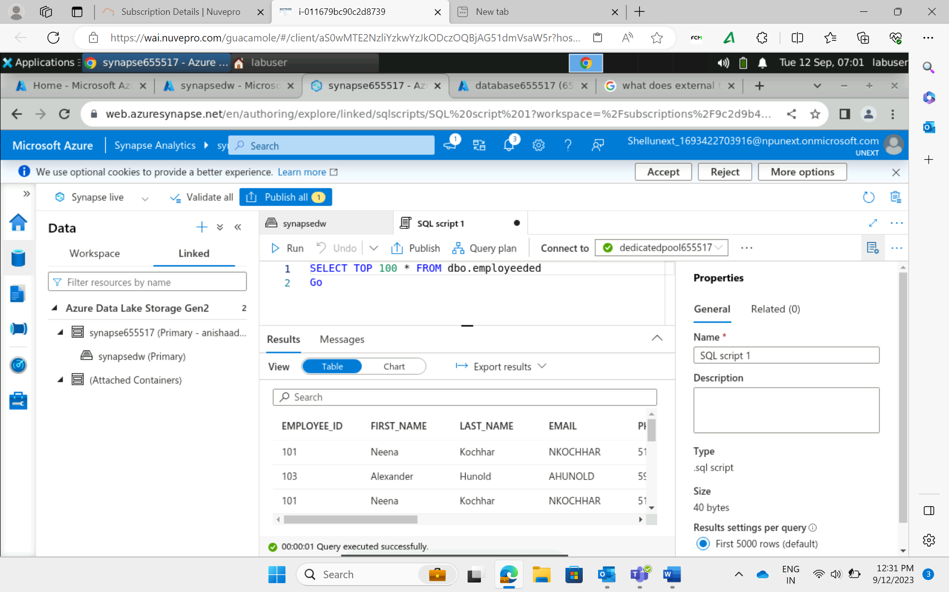
SQL Query on top of a file
Bulk Load
External Table on top of a file

Slide 5
DAY 11: 13-09-2023
Introduction to Power BI
Connected to various data sources: Excel, CSV, etc
Data loading and transformation: Eliminating duplicates, handling dates and missing values
Established and Managed Relationships
Used Power Query Editor: Cleanses data, handles missing data, adding new data
Visualizations and Filters on a visual/ a page/ all pages
Implicit and Explicit Measures
Row Level Security
Aggregation Functions
Formed DAX Expressions

Slide 6
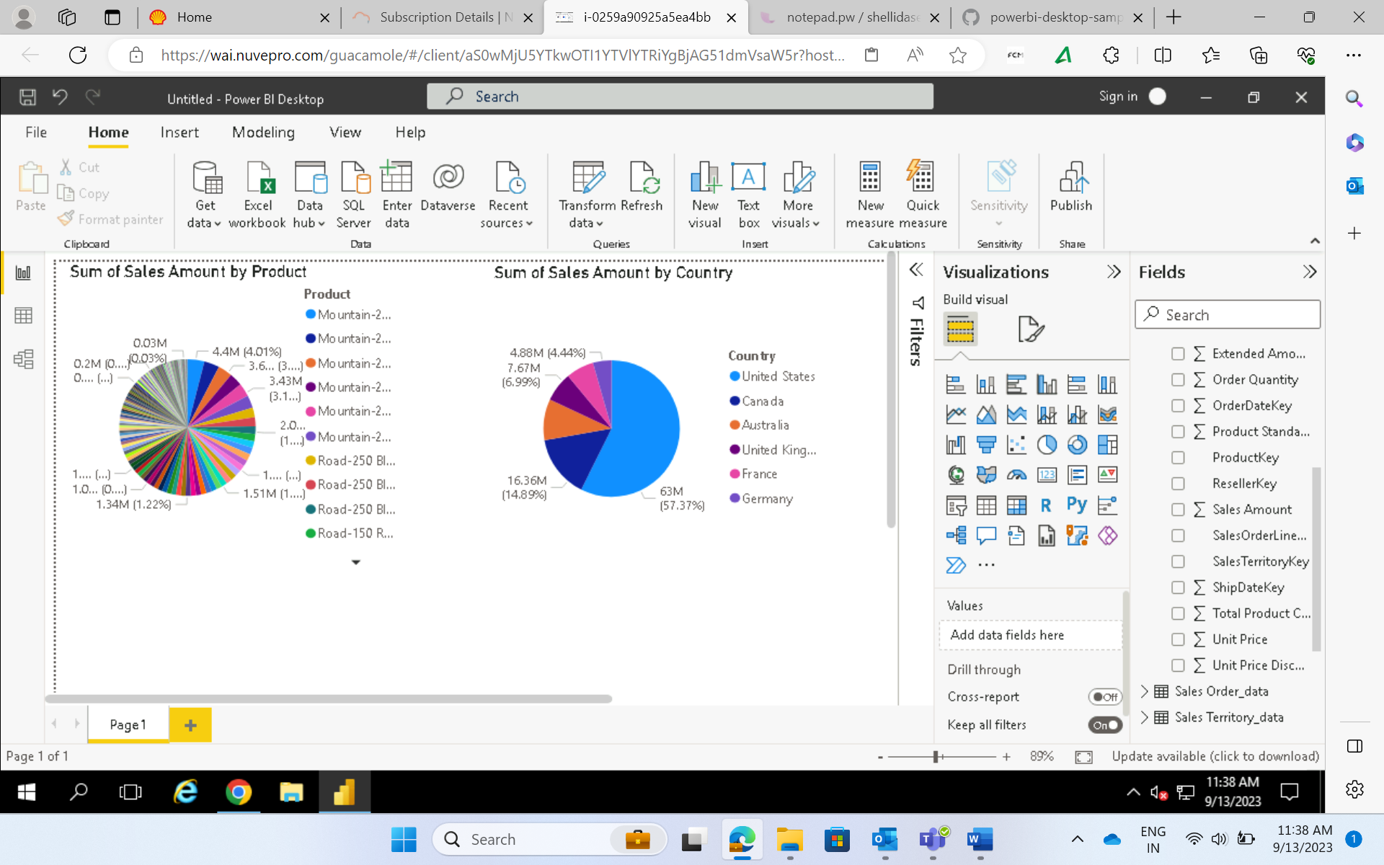
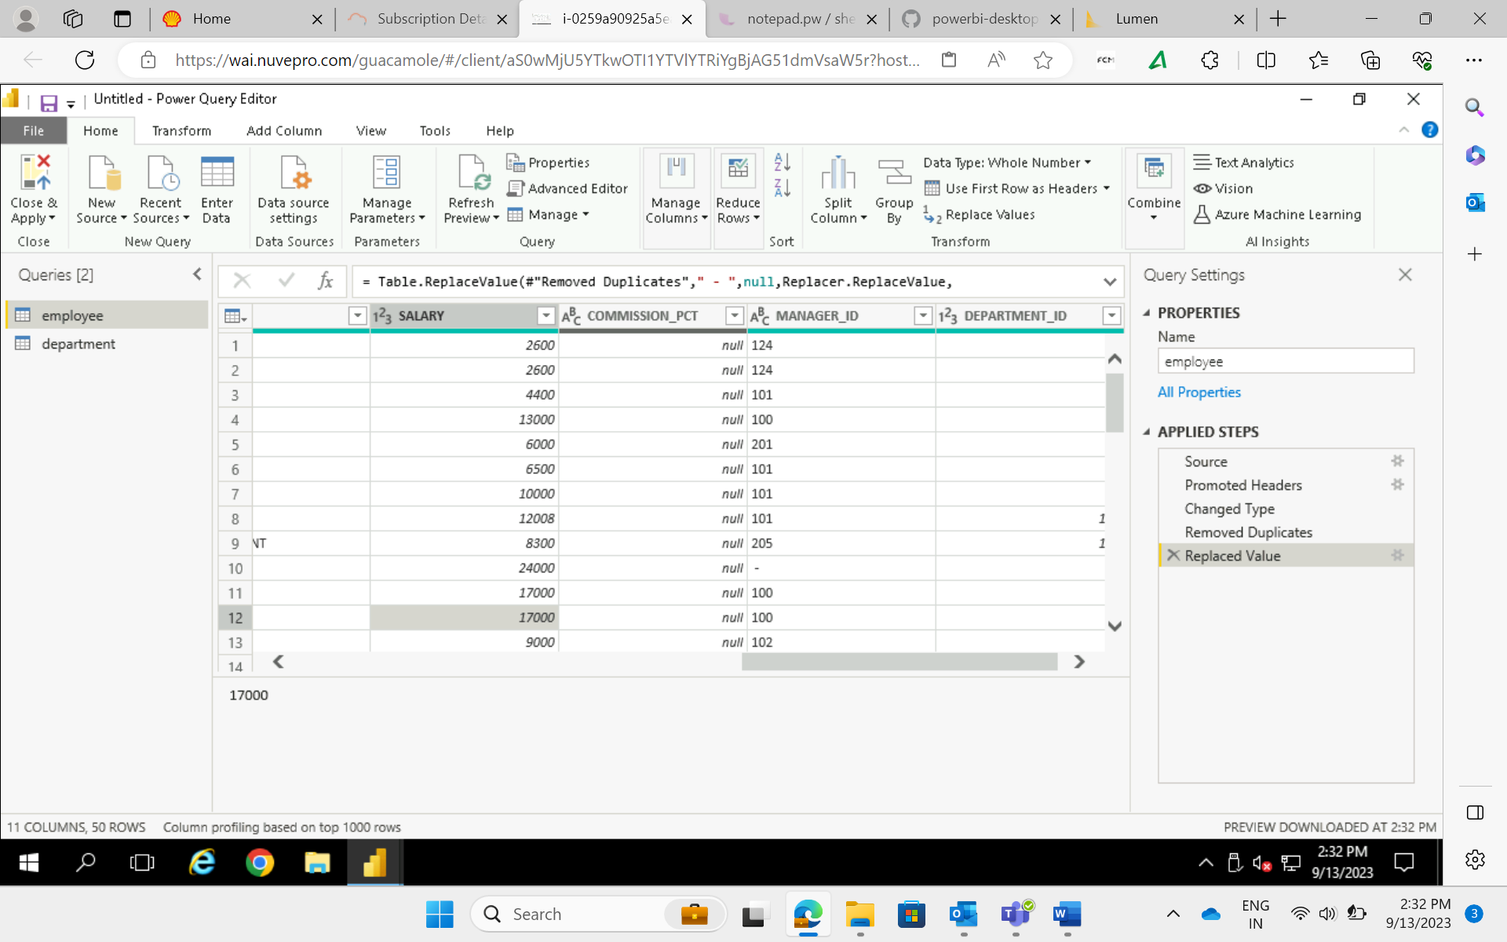
Few Reports on Sales Data
Cleansing data using power query editor

Slide 7
DAY 12: 14-09-2023
Reports and Dashboards
Understanding various chart types: Line, Bar, Slice, Pie
Univariate and Bivariate Analysis
Performing drill up/ drill down operations on hierarchical data
Managing Roles and Applying View on those roles
Case Study: Worked with RetailSales dataset and generated insightful visualizations

Slide 8
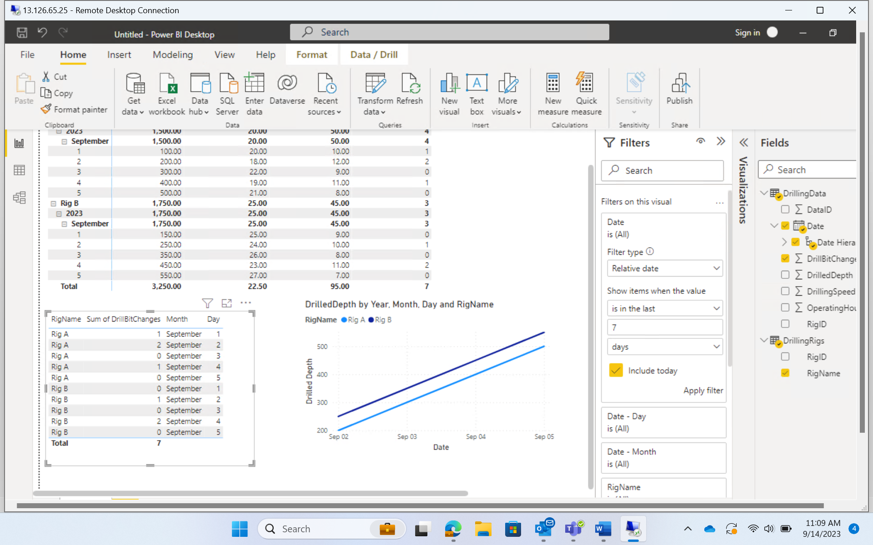
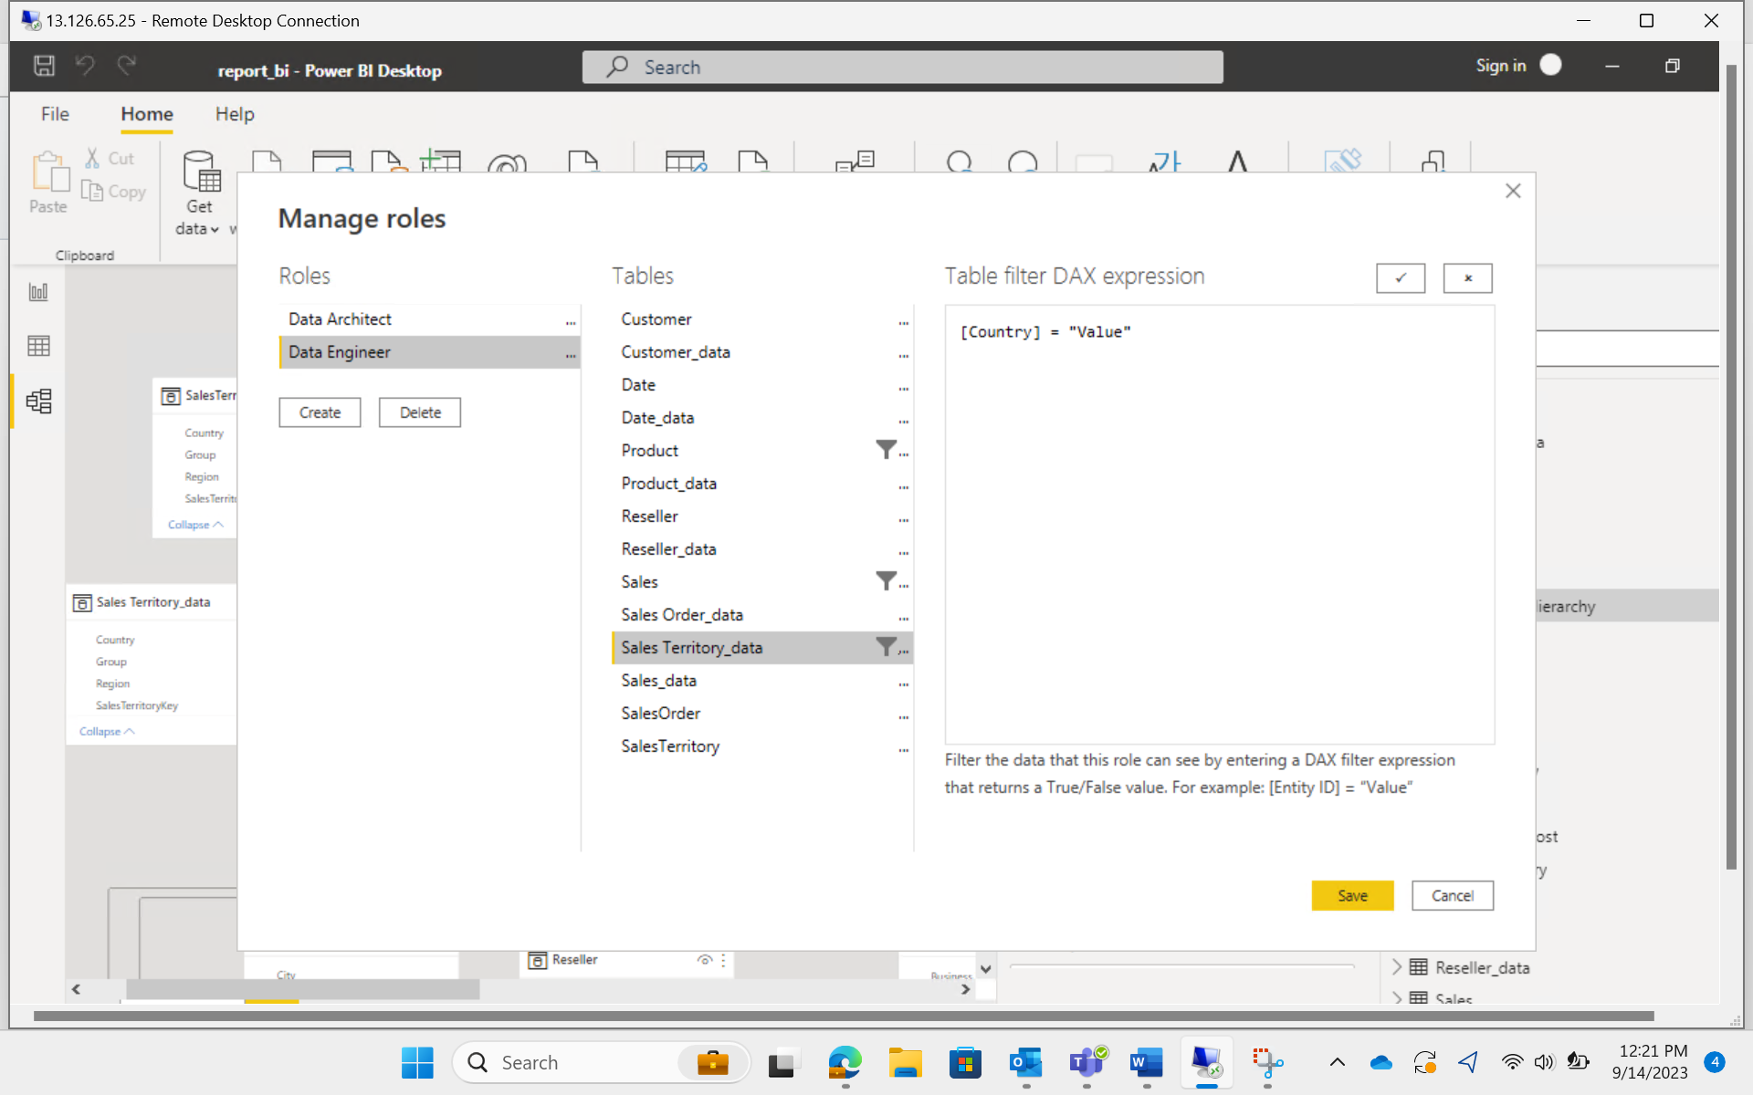
Few Reports on Drilled Data
Managing Roles for Access Control

Slide 9
DAY 13: 15-09-2023
Power BI Case Study – Loading, Transforming, and Performing Visualizations, deriving infererences from data
Basics of Python – lists, tuples, dictionaries
Operations: Arithmetic, Logical, Comparison, Membership
String Formatting
Functions: zip(), enumerate(), counter(), range()
Performed operations on retail data with string and list functions

Slide 10
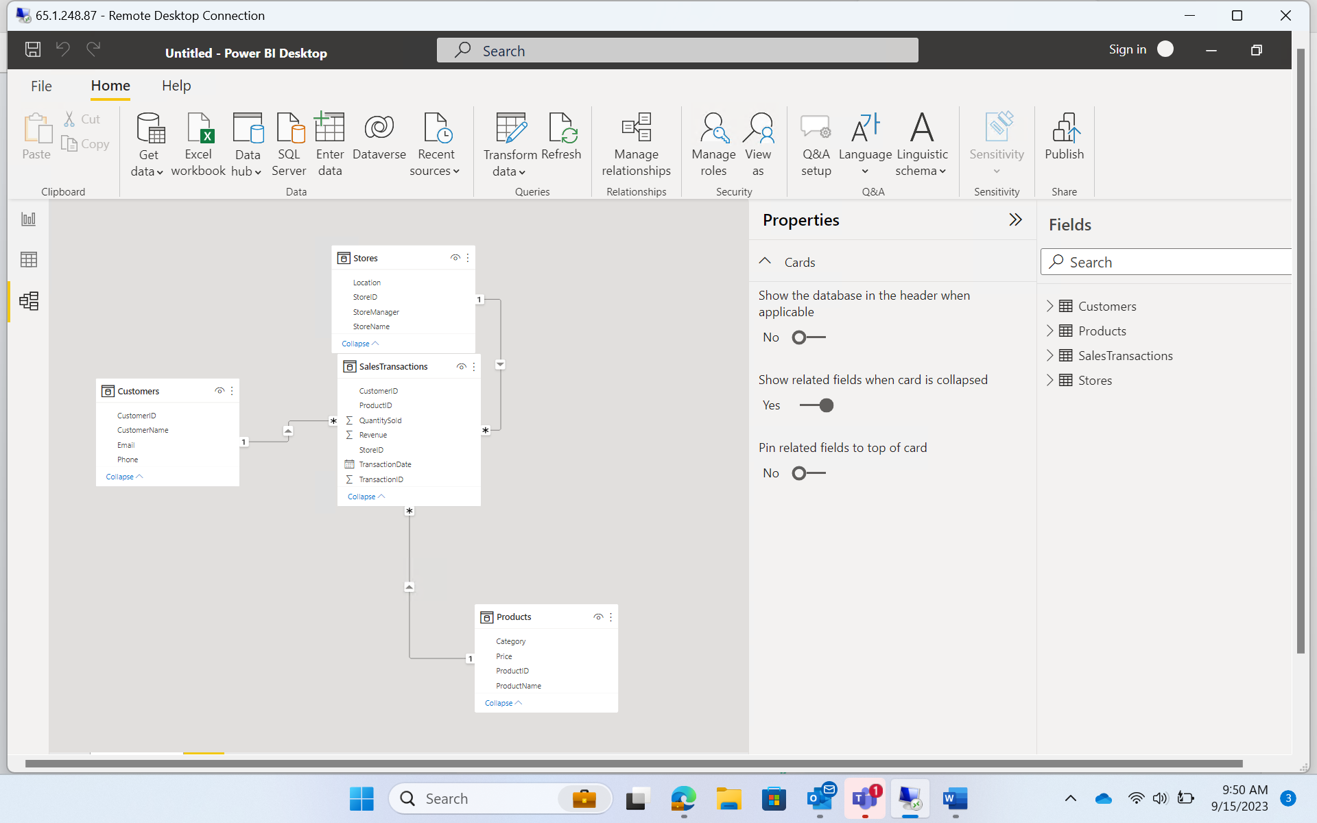
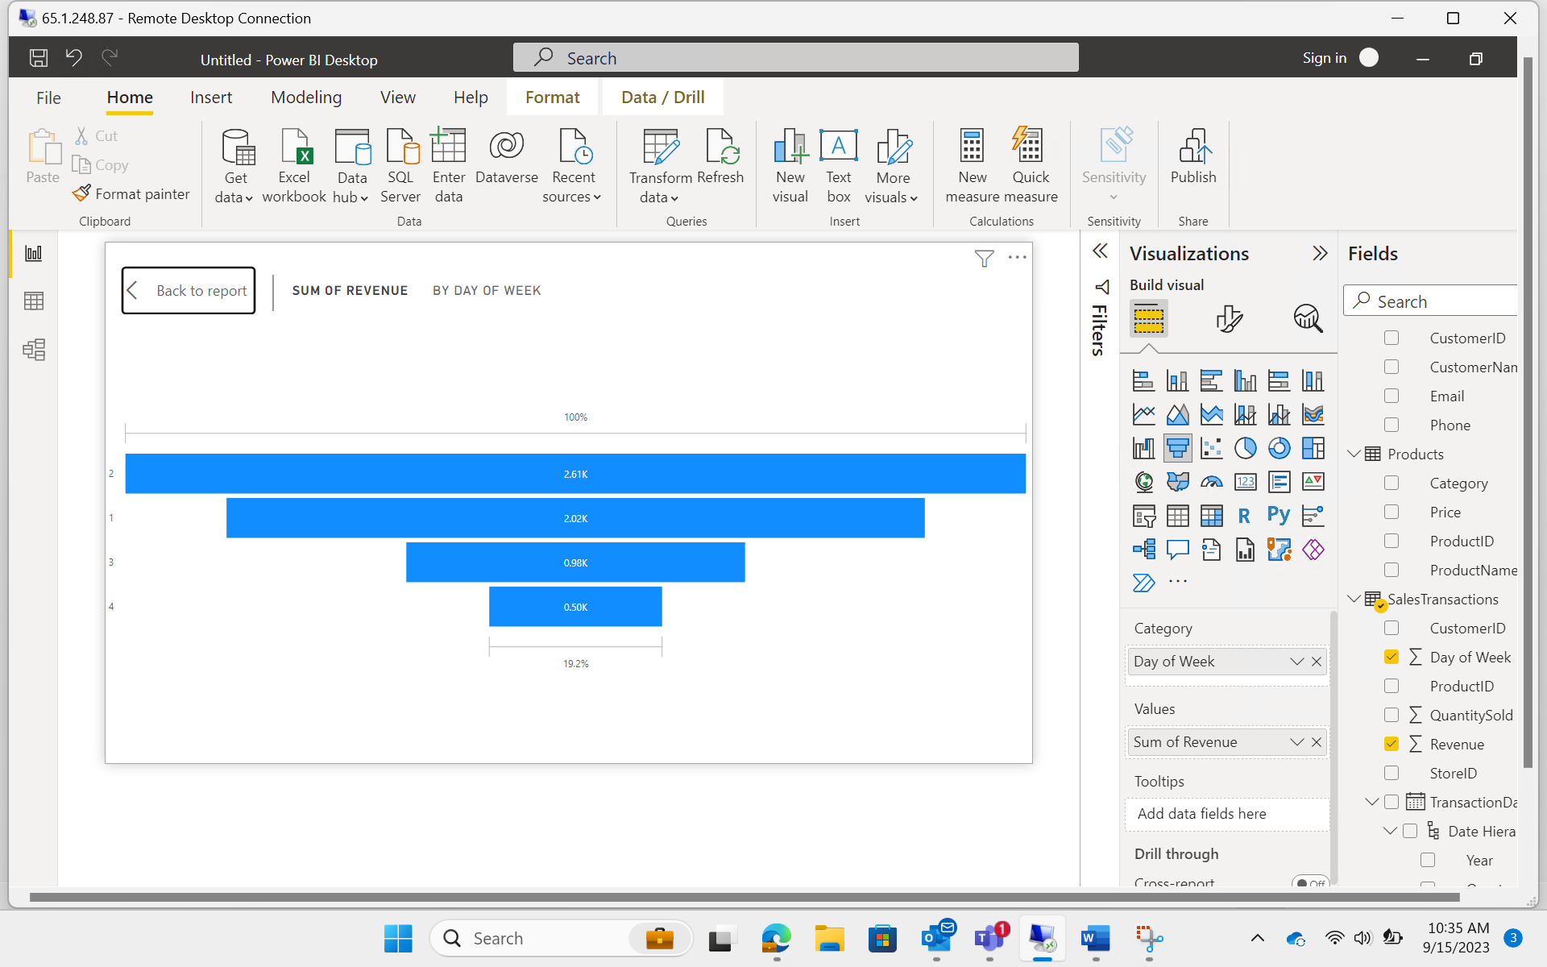
ASSESSMENT – POWER BI
Managed Relationships between tables
Report and Analysis: As seen sales are higher on day 2 of the week

Slide 11
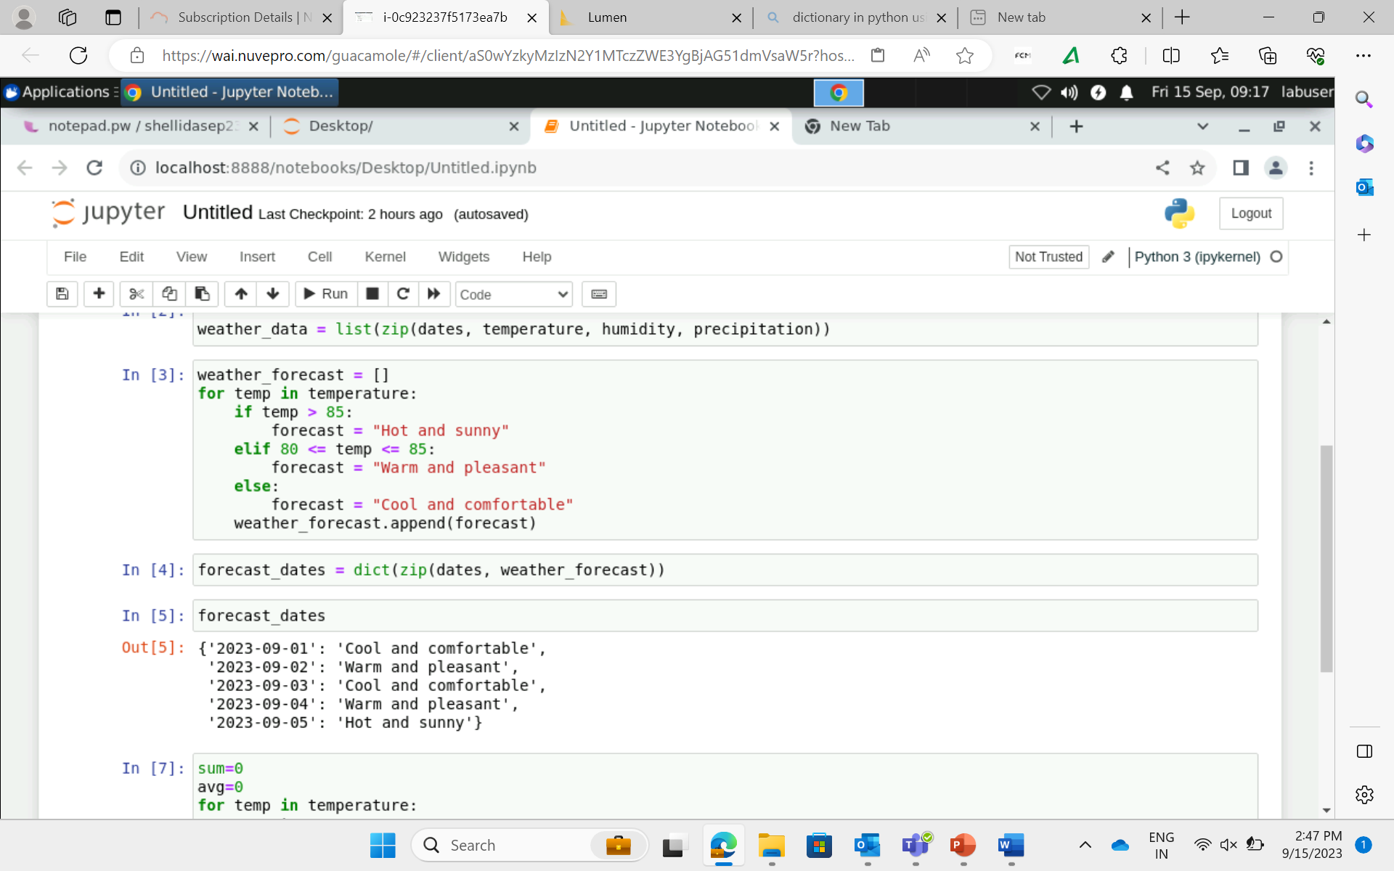
Using lists, dictionaries, looping, zip(), enumerate()

